Slide 1
Serverless Approach to Working with Data
Jakub Nowacki

Slide 2
whoami
Lead Machine Learning Engineer @ Sotrender (sotrender.com)
Trainer @ Sages (sages.com.pl)
I can code, I do maths
@jsnowacki

Slide 3


So you’ve got a function…

Slide 4



Your options

Slide 5

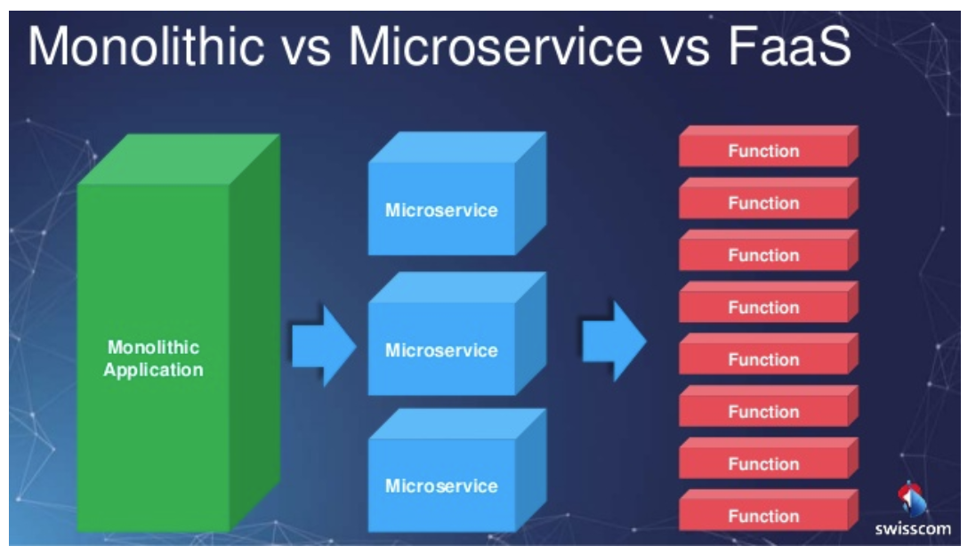
Function as a Service (FaaS)
Source: https://blog.algorithmia.com/serverless-computing/

Slide 6






Where can I run FaaS?

Slide 7





Poliglot(ish)

Slide 8
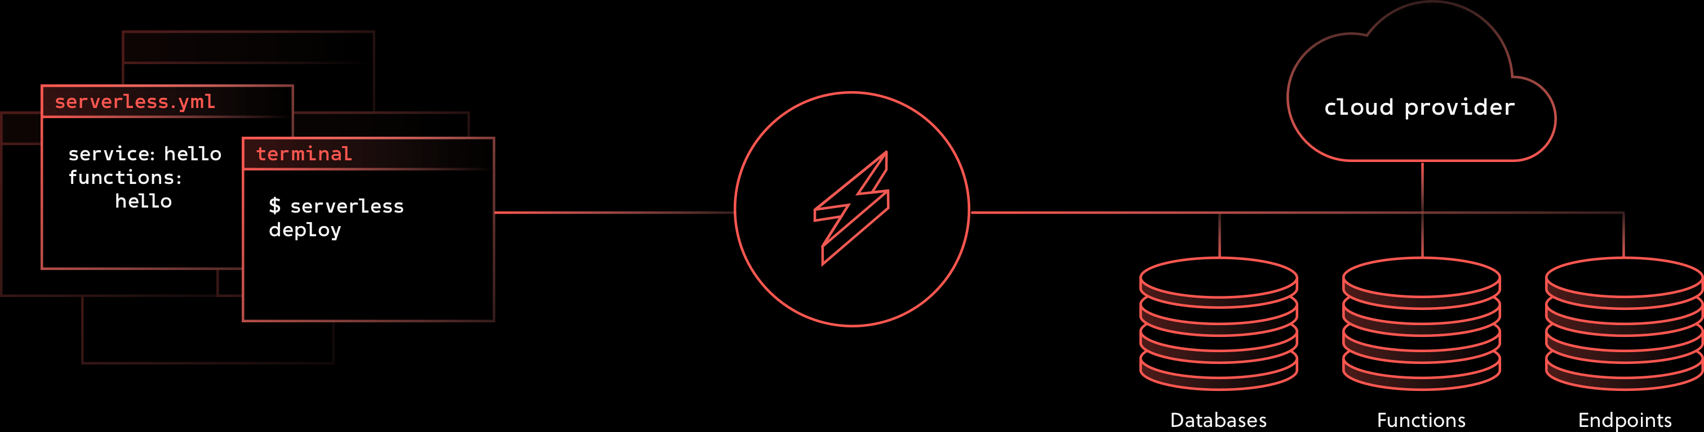
Serverless
Source: https://serverless.com/framework

Slide 9
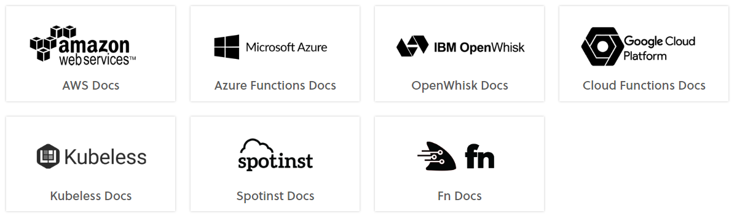
Providers

Slide 10
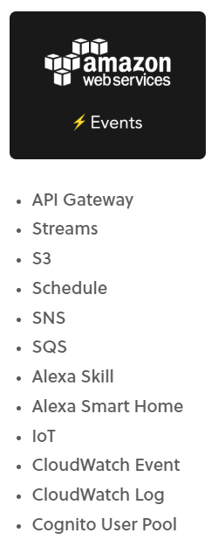
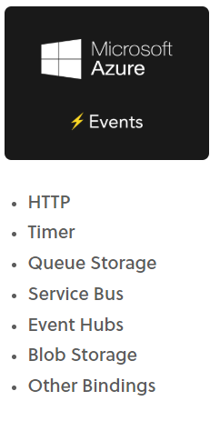
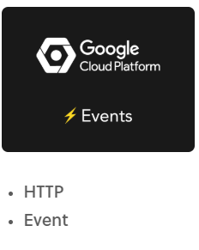
Events

Slide 11



Getting data from the Internets

Slide 12

The task
Get event data from Wikipedias main page, in particular news.
Save extracted data to JSON file and a record in a database. Data should be pulled daily.

Slide 13




The task - architecture

Slide 14

Let’s do this!
GitHub: https://github.com/jsnowacki/serverless-wiki-crawler

Slide 15
Thank you!
Questions?

